Slide 1

ILP 2023 – Extra About Recursion
Matthieu DE MARI – Singapore University of Technology and Design

Slide 2
Recursion: definition
Definition (recursion): Recursion is a common mathematical and programming concept. It means that a function can be defined by calling itself.

Slide 3
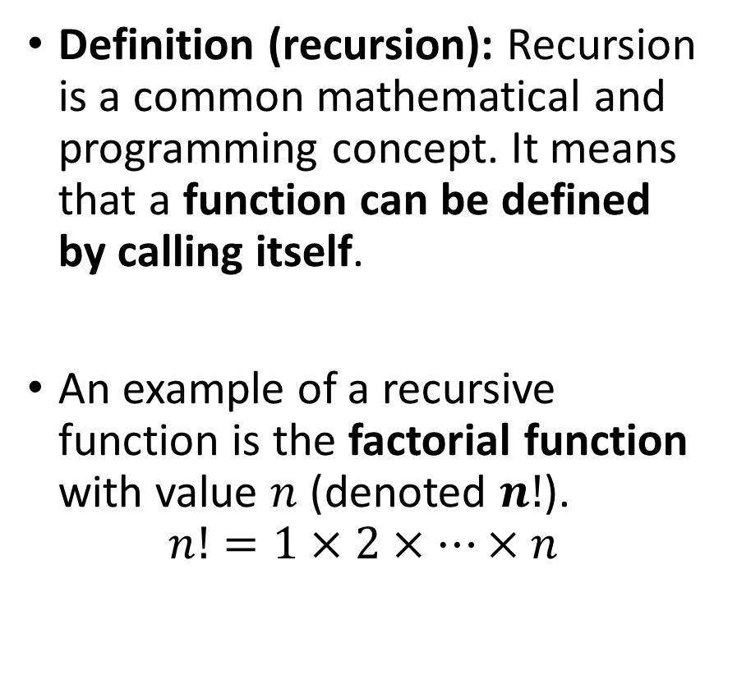
Recursion: definition
Definition (recursion): Recursion is a common mathematical and programming concept. It means that a function can be defined by calling itself.
An example of a recursive function is the factorial function with value $n$ (denoted $n!$).
$$n!=1×2×…×n$$

Slide 4

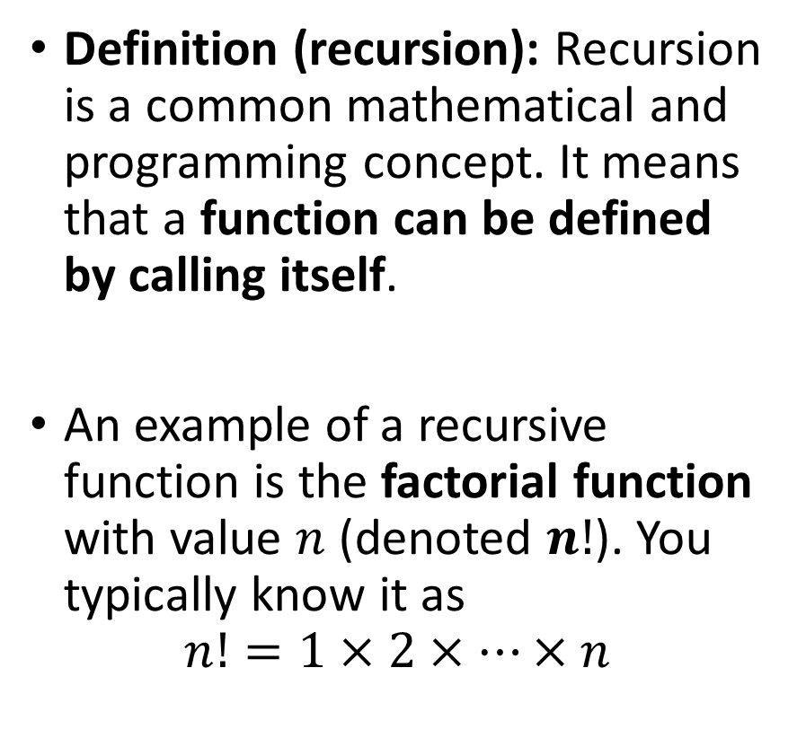
Recursion: definition
Definition (recursion): Recursion is a common mathematical and programming concept. It means that a function can be defined by calling itself.
An example of a recursive function is the factorial function with value $n$ (denoted $n!$). You typically know it as
$$n!=1×2×…×n$$
The factorial function value can be defined in a recursive manner, as follows.
$$n!= \left\{\begin{matrix}1 & if n=1 \\ n×\left(\left(n−1\right)!\right) & if n>1\end{matrix}\right.$$

Slide 5
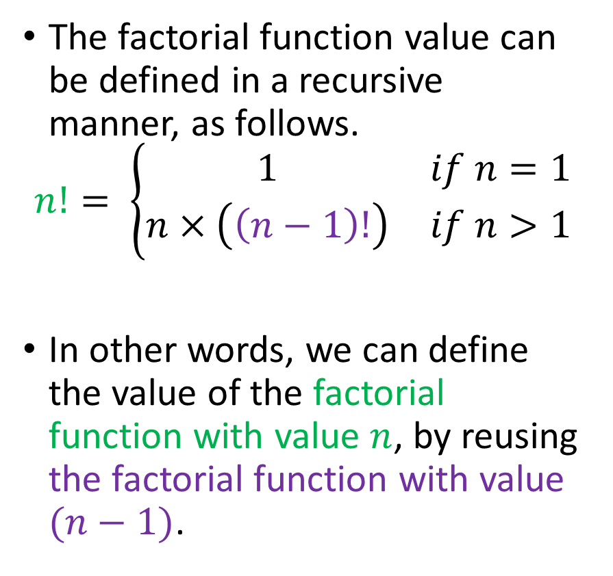
Recursion: definition
Definition (recursion): Recursion is a common mathematical and programming concept. It means that a function can be defined by calling itself.
An example of a recursive function is the factorial function with value $n$ (denoted $n!$). You typically know it as
$$n!=1×2×…×n$$
The factorial function value can be defined in a recursive manner, as follows.
$$n!= \left\{\begin{matrix}1 & if n=1 \\ n×\left(\left(n−1\right)!\right) & if n>1\end{matrix}\right.$$
In other words, we can define the value of the factorial function with value $n$, by reusing the factorial function with value $(n−1)$.

Slide 6
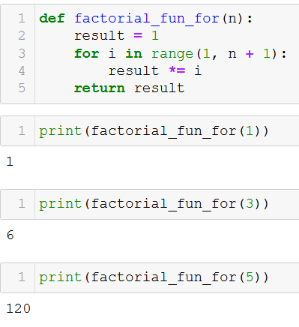
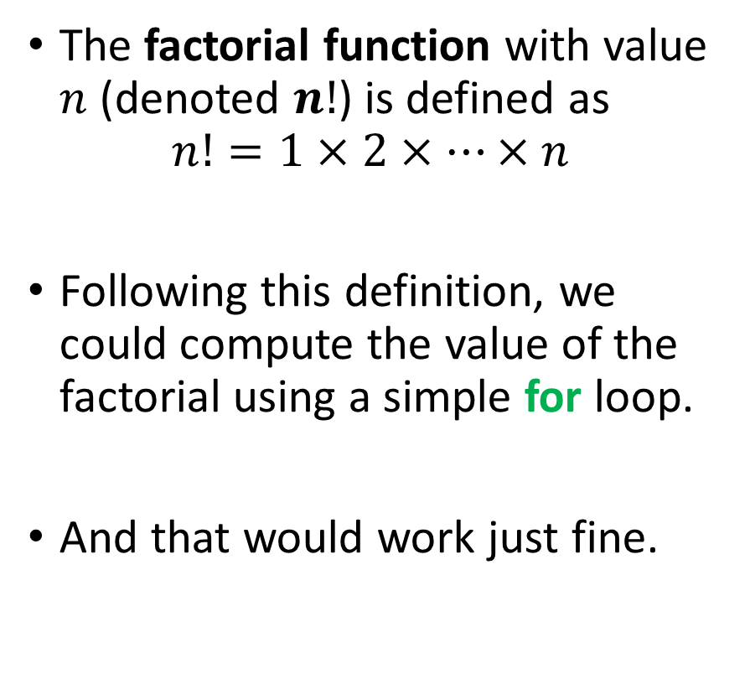
Recursion vs. for loop
The factorial function with value $n$ (denoted $n!$) is defined as
$$n!=1×2×…×n$$
Following this definition, we could compute the value of the factorial using a simple for loop.
And that would work just fine.

Slide 7
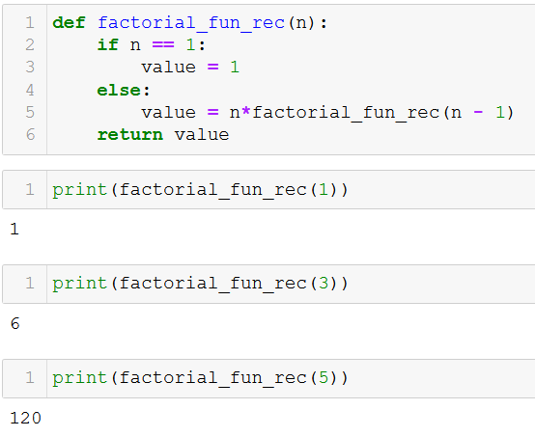
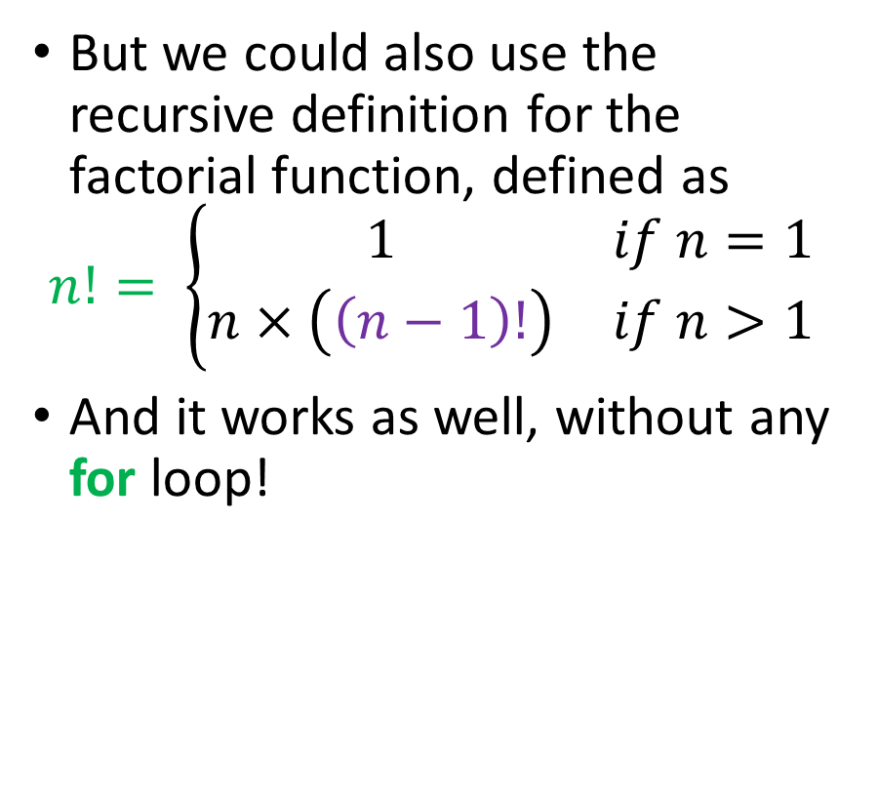
Recursion vs. for loop
But we could also use the recursive definition for the factorial function, defined as
$$n!= \left\{\begin{matrix}1 & if n=1 \\ n×\left(\left(n−1\right)!\right) & if n>1\end{matrix}\right.$$
And it works as well, without any for loop!

Slide 8
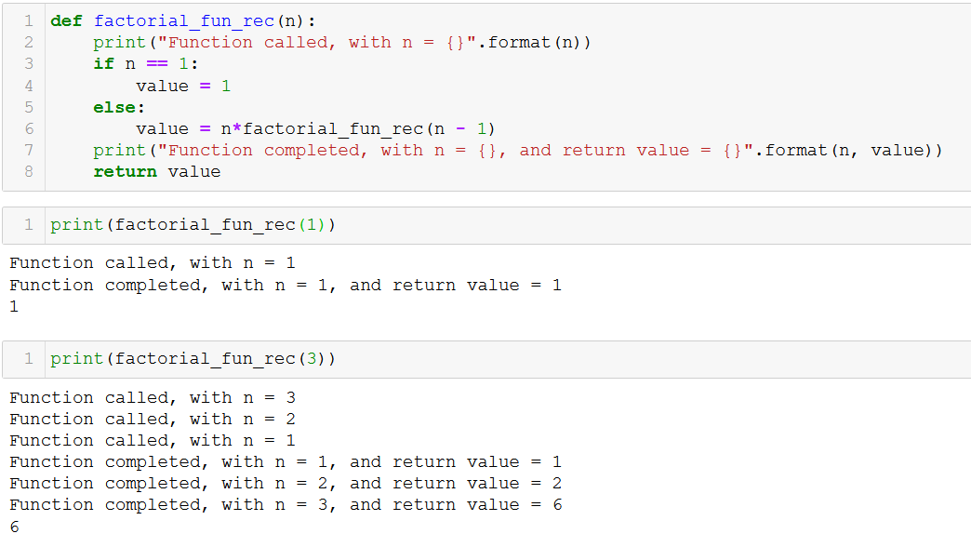
Recursion vs. for loop
What happens in practice? Multiple concurrent runs of a function.

Slide 9
Recursion vs. for loop
Recursion is an interesting trick for computing the value of a function, which would normally require an iterative for loop.

Slide 10
Recursion vs. for loop
Recursion is an interesting trick for computing the value of a function, which would normally require an iterative for loop.
In some cases, the value of a function can only be computed using a recursive approach.

Slide 11
Recursion vs. for loop
Recursion is an interesting trick for computing the value of a function, which would normally require an iterative for loop.
In some cases, the value of a function can only be computed using a recursive approach.
In some cases, recursion might be faster than an iterative for loop. Sometimes it is not.
→ Something we will discuss once we investigate computational complexity (a.k.a. the science of designing the best code for a task)

Slide 12
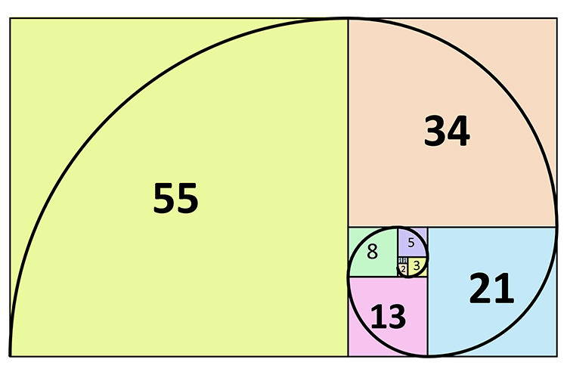
Practice activities: recursion vs. for loops
Let us practice a bit
Activity 5 – Fibonacci sequence.ipynb

Slide 13
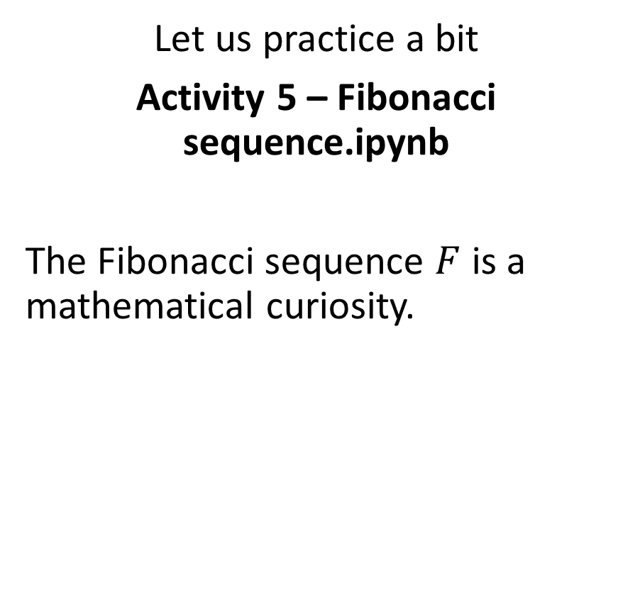
Practice activities: recursion vs. for loops
Let us practice a bit
Activity 5 – Fibonacci sequence.ipynb
The Fibonacci sequence $F$ is a mathematical curiosity.

Slide 14
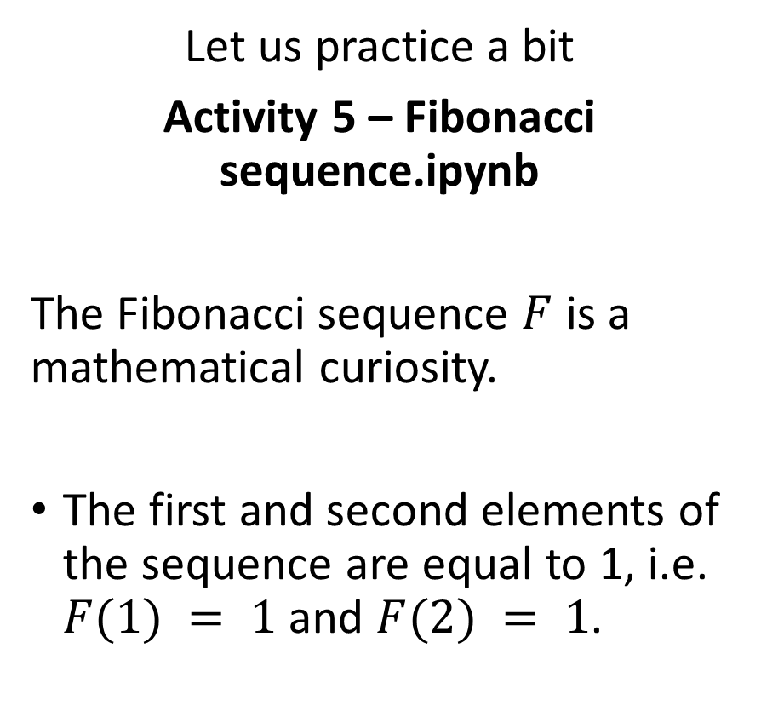
Practice activities: recursion vs. for loops
Let us practice a bit
Activity 5 – Fibonacci sequence.ipynb
The Fibonacci sequence $F$ is a mathematical curiosity.
The first and second elements of the sequence are equal to 1, i.e. $F(1) = 1$and $F(2) = 1$.

Slide 15

Practice activities: recursion vs. for loops
Let us practice a bit
Activity 5 – Fibonacci sequence.ipynb
The Fibonacci sequence $F$ is a mathematical curiosity.
The first and second elements of the sequence are equal to 1, i.e. $F(1) = 1$and $F(2) = 1$.
The $n$-th Fibonacci element, with $n≥ 3$, is defined as the sum of its previous two elements, i.e. $F(n) = F(n−1) + F(n−2).$

Slide 16
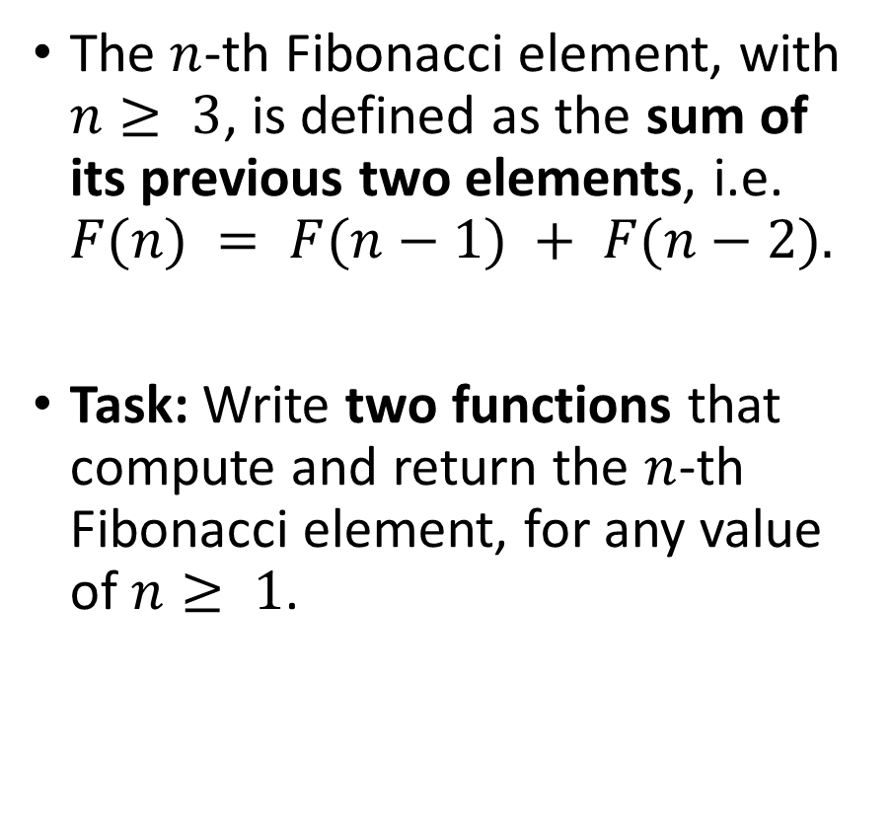
Practice activities: recursion vs. for loops
Let us practice a bit
Activity 5 – Fibonacci sequence.ipynb
The Fibonacci sequence $F$ is a mathematical curiosity.
The first and second elements of the sequence are equal to 1, i.e. $F(1) = 1$and $F(2) = 1$.
The $n$-th Fibonacci element, with $n≥ 3$, is defined as the sum of its previous two elements, i.e. $F(n) = F(n−1) + F(n−2).$
Task: Write two functions that compute and return the $n$-th Fibonacci element, for any value of $n≥ 1$.

Slide 17
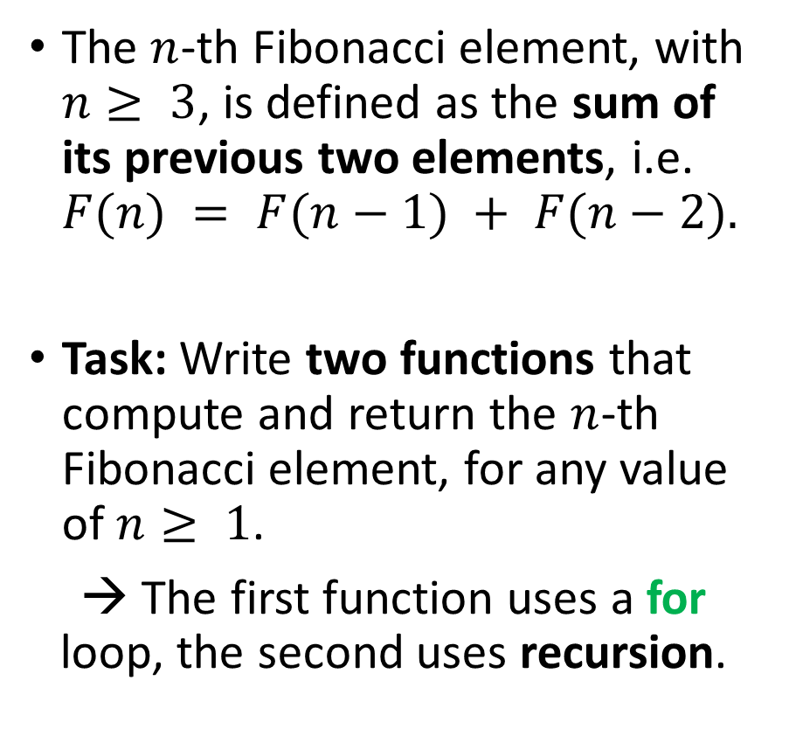
Practice activities: recursion vs. for loops
Let us practice a bit
Activity 5 – Fibonacci sequence.ipynb
The Fibonacci sequence $F$ is a mathematical curiosity.
The first and second elements of the sequence are equal to 1, i.e. $F(1) = 1$and $F(2) = 1$.
The $n$-th Fibonacci element, with $n≥ 3$, is defined as the sum of its previous two elements, i.e. $F(n) = F(n−1) + F(n−2).$
Task: Write two functions that compute and return the $n$-th Fibonacci element, for any value of $n≥ 1$.
→ The first function uses a for loop, the second uses recursion.

